Slide 1
"Unit 12: "For Live Session"
Chad Madding

Slide 2
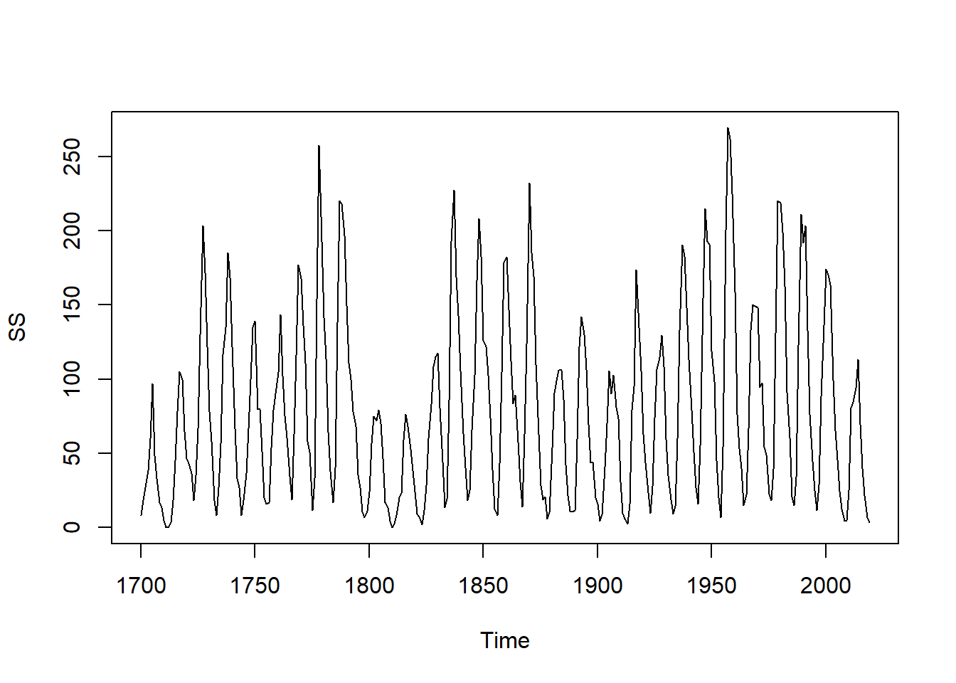
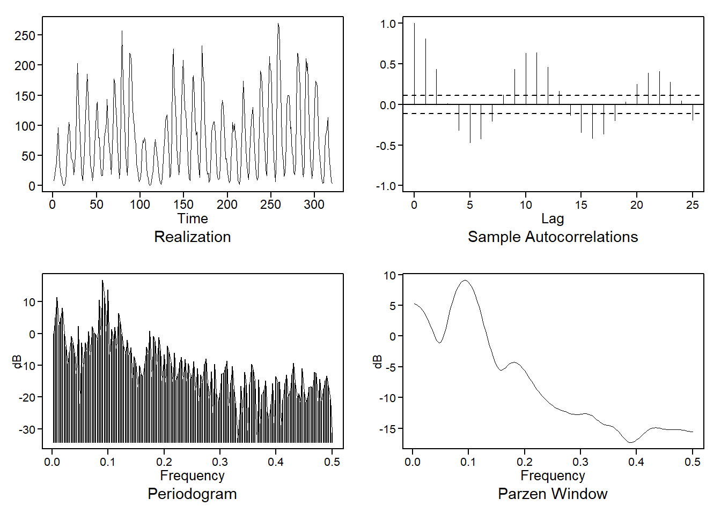
In preparation for the live session, please complete the following. Be sure and submit your work to the "Unit 11: "For Live Session" Assignment" assignment on 2DS:
Please address each activity on at least one PowerPoint slide and submit via the online campus.
Our purpose is to update the Sunspot analysis. Go to this website.
Download the most current yearly mean sunspot data and with this data:
Plot the data

Slide 3
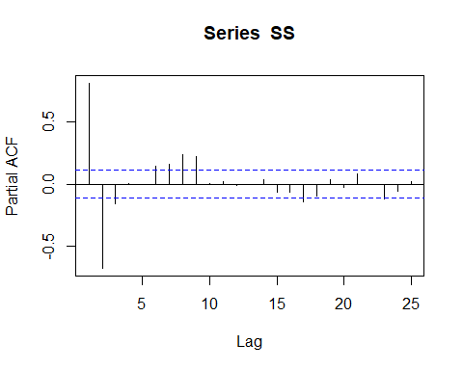
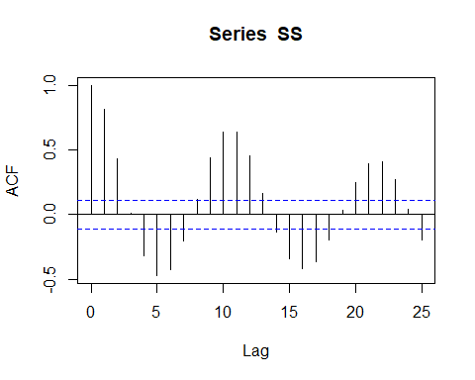
Comment on its stationarity.
Sample autocorrelations damp quickly and seem to indicate stationarity. A unit root test also shows stationarity. With a frequency peek at 0.0937 there does seem to be some seasonality in the data (1/0.937=10.67).
adf.test(SS)
## Warning in adf.test(SS): p-value smaller than printed p-value
## ## Augmented Dickey-Fuller Test ## ## data: SS ## Dickey-Fuller = -5.2163, Lag order = 6, p-value = 0.01 ## alternative hypothesis: stationary

Slide 4
Use aic5.wge to estimate the p and q of the model. You may use your choice of AIC/AICC/BIC.
All the AIC’s point to and AR(9).
#playing around with the Forecast package to see what it picks #differencing needed for Stationarizing the series ndiffs(SS)
## [1] 0
SSAA=auto.arima(SS,stepwise = FALSE, approximation=FALSE, seasonal = TRUE, stationary = TRUE) SSAA
## Series: SS ## ARIMA(3,0,0) with non-zero mean ## ## Coefficients: ## ar1 ar2 ar3 mean ## 1.2837 -0.4927 -0.1439 78.7834 ## s.e. 0.0553 0.0864 0.0554 4.0336 ## ## sigma^2 estimated as 654.6: log likelihood=-1490.74 ## AIC=2991.47 AICc=2991.67 BIC=3010.32
#Checking the AIC options aic5.wge(SS,p=0:15,q=0:2,type="aic")
## ---------WORKING... PLEASE WAIT... ## ## ## Five Smallest Values of aic
## p q aic ## 28 9 0 6.363586 ## 48 15 2 6.364225 ## 29 9 1 6.369581 ## 31 10 0 6.369614 ## 47 15 1 6.372261
I am choosing to go with the AR(3) model from the auto.arima.

Slide 5
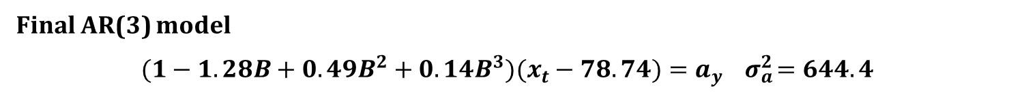
Fit the model using your model identification (p and q). You may use any of the estimates you like (maximum likelihood, Yule–Walker, Burg).
#Maximum Likelihood Estimation SS3.mle=est.ar.wge(SS,p=3,type='mle')
## ## Coefficients of Original polynomial: ## 1.2837 -0.4927 -0.1439 ## ## Factor Roots Abs Recip System Freq ## 1-1.4709B+0.7681B^2 0.9575+-0.6206i 0.8764 0.0915 ## 1+0.1873B -5.3398 0.1873 0.5000
mean(SS) #[1] 78.735
## [1] 78.735
SS3.mle$avar #[1] 644.4032
## [1] 644.4032
Final AR(3) model
$$(1−1.28B+0.49B^{2}+0.14B^{3})(x_{t}−78.74)=a_{y} { σ}_{a}^{2}=644.4$$

Slide 6
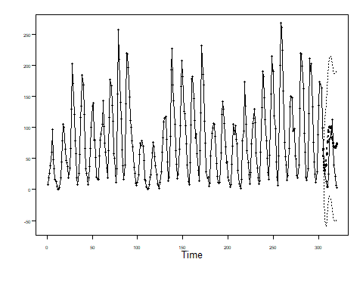
Use this model to generate an ASE from forecasting the last 15 years of sunspot data. (You will use this to compare your models to your peer’s models.)
The maximum likelihood scored just a bit better so I decided to stay with it’s forecast.
SS3.mle.est = fore.arma.wge(SS, phi = SS3.mle$phi, theta = 0,lastn = T, n.ahead = 15)
SS3.mle.ase = mean((SS[(320-15+1):320] - SS3.mle.est$f)^2) SS3.mle.ase
## [1] 1802.668

Slide 7
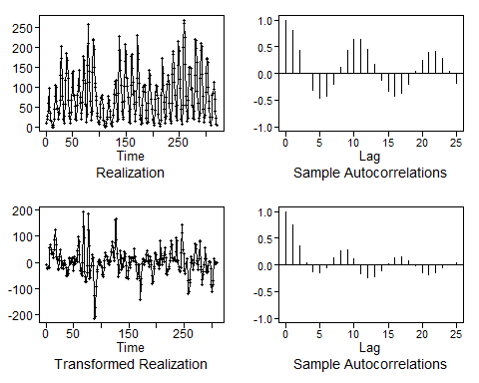
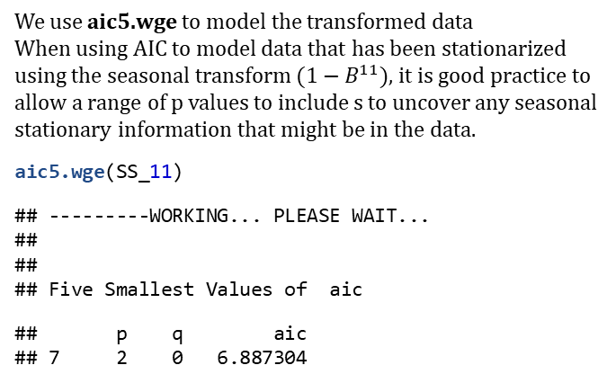
Now fit a seasonal model to the Sunspot data (you pick the value of s), and find the ASE for this model using the last 15 years of sunspot data.
Base on the overfit table we can now transform the data to remove the seasonality.
Transform data to create Yt=(1-B11)Xt
#rep will repeat the 11 zeros then we can add a one at the end SS_11 = artrans.wge(SS,phi.tr = c(rep(0,10),1))
We use aic5.wge to model the transformed data When using AIC to model data that has been stationarized using the seasonal transform $(1−B^{11})$, it is good practice to allow a range of p values to include s to uncover any seasonal stationary information that might be in the data.
aic5.wge(SS_11)
## ---------WORKING... PLEASE WAIT... ## ## ## Five Smallest Values of aic
## p q aic ## 7 2 0 6.887304
Seasonal ARMA(2,0) s = 11
AIC selects an AR(2,0) model. Factoring the ARMA(2,0) model we obtain:
AR2 = est.arma.wge(SS_11,p = 2,q = 0)
The transformed data appear stationary, so we use AIC to identify a model.
SS_11_AR2.ASE = mean((SS[(length(SS)-14):length(SS)] - f$f)^2)
## [1] 2828.898

Slide 8
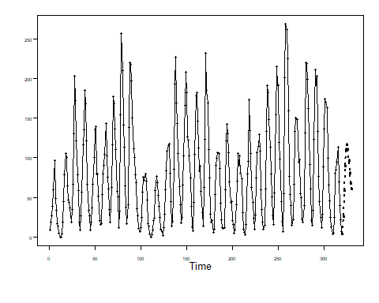
Describe which model you prefer, and why.
The best model turned out to be the AR(3) that auto.arima from the Forecast package picked. The ASR was also lower than the seasonal model. This was a stationary model to start with and that could have lead to the better performance.
Use your best model (the one you choose) to forecast the next 10 years of sunspot data.
Final AR(3) model
(1-1.28B+0.49B2+0.14B3)(xt-78.74)=ay σa2=644.4
SS3.f = fore.arma.wge(SS,phi = SS3.mle$phi,theta = 0, n.ahead = 10,limits = F, lastn = F)
[1] 25.83318 58.16266 89.19825 109.91149 116.55944 110.42395 96.29325 80.22067 67.43328 60.96974

Slide 9
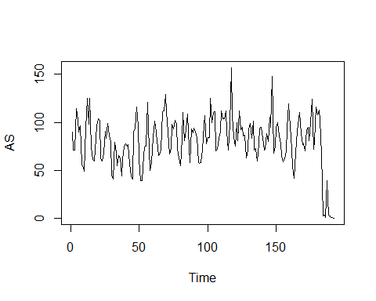
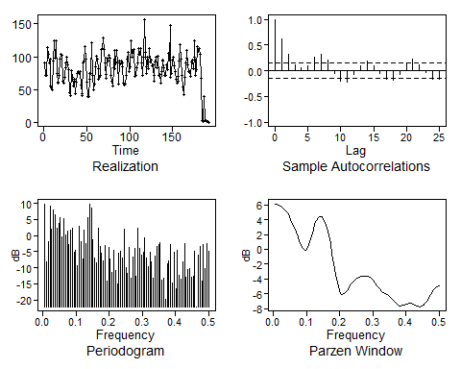
Given what you have learned so far, model the Accuspike web page hits data, and provide the desired forecasts.
Plot the Data
AS = read.csv("accuspike.csv",header = TRUE) #Convert to a time series AS = ts(AS$Active.Users)
#A simple plot of the data plot(AS)
#Plot Data, Sample Autocorrelations, Periodogram, and Parzen Spectral Estimate plotts.sample.wge(AS, arlimits = TRUE)

Slide 10
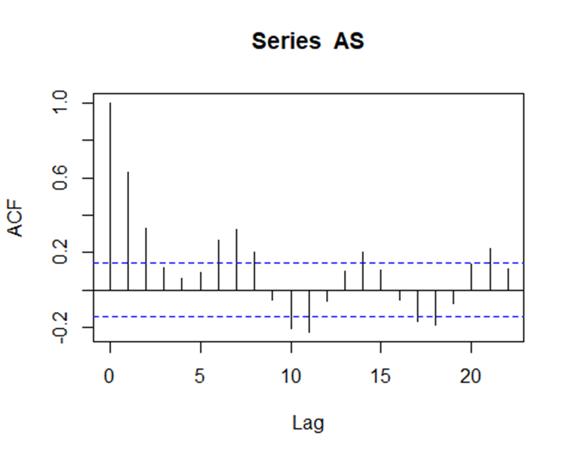
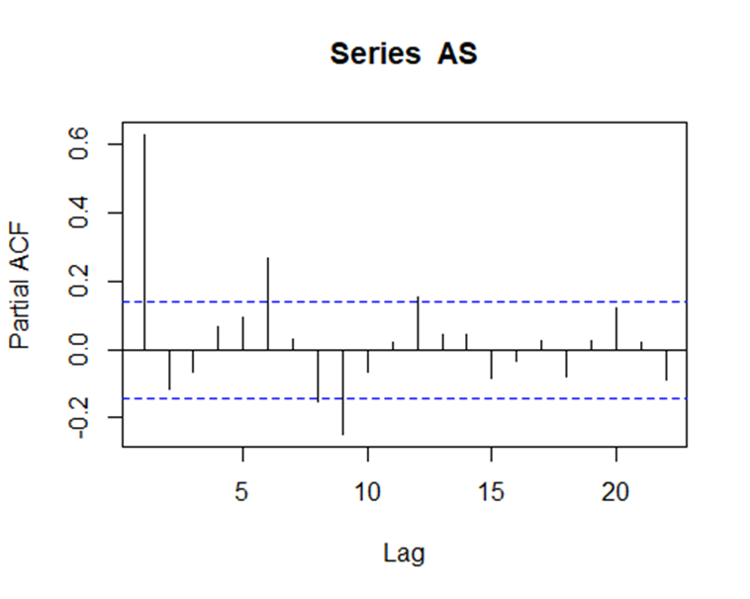
Sample autocorrelations damp quickly and seem to indicate stationarity. A unit root test also shows stationarity. With a frequency peek around 0.15 (1/0.15=6.67) there could be some weekly seasonality in the data.

Slide 11
Checking the AIC options
#Checking the AIC options aic5.wge(AS)
## ---------WORKING... PLEASE WAIT... ## ## ## Five Smallest Values of aic
## p q aic ## 17 5 1 6.009981 ## 14 4 1 6.019087 ## 7 2 0 6.039300 ## 4 1 0 6.040475 ## 5 1 1 6.041323
#Use the Forecast package to see what it picks #differencing needed to stationarize the series ndiffs(AS)
## [1] 0
ASAA=auto.arima(AS,stepwise = FALSE, approximation=FALSE) ASAA
## Series: AS ## ARIMA(4,0,1) with non-zero mean ## ## Coefficients: ## ar1 ar2 ar3 ar4 ma1 mean ## 1.3614 -0.5114 -0.1159 0.2081 -0.6585 76.7454 ## s.e. 0.1281 0.1443 0.1228 0.0759 0.1140 8.4863 ## ## sigma^2 estimated as 398.9: log likelihood=-844.82 ## AIC=1703.65 AICc=1704.26 BIC=1726.45
ASAA.f=forecast(ASAA, h=14)
The forecast package picked a ARMA(4,1) and that matches one to the AIC5’s so we will be using the (4,1).

Slide 12
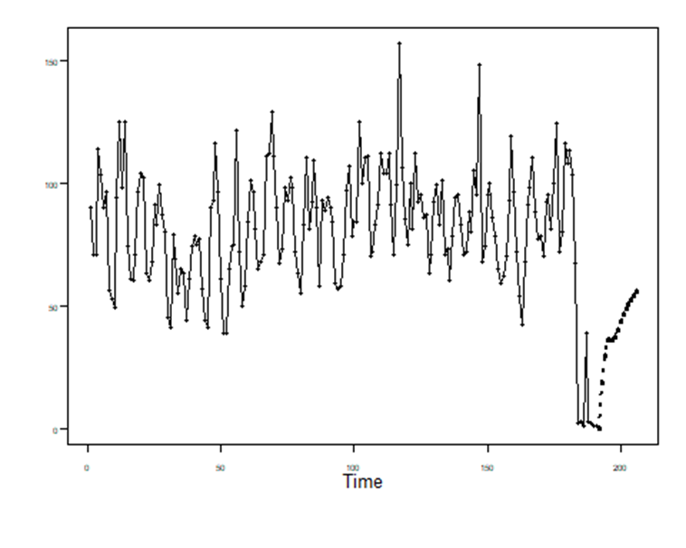

#Fit with 4,1 AS41=est.arma.wge(AS,p=4,q=1,factor = TRUE)
## ## Coefficients of Original polynomial: ## 1.3614 -0.5114 -0.1159 0.2081 ## ## Factor Roots Abs Recip System Freq ## 1-0.9366B 1.0676 0.9366 0.0000 ## 1-0.8693B+0.4998B^2 0.8695+-1.1156i 0.7070 0.1446 ## 1+0.4445B -2.2498 0.4445 0.5000 ## ##
AS41$phi #[1] 1.3614265 -0.5113544 -0.1158767 0.2080940
## [1] 1.3614265 -0.5113544 -0.1158767 0.2080940
AS41$theta #[1] 0.6585371
## [1] 0.6585371
mean(AS) #[1] 80.35
## [1] 80.35417
AS41$avar #[1] 386.29
## [1] 386.2893
Final ARMA(4,1) model
$$(1−1.36B+0.51B^{2}+0.12B^{3}−0.21B^{4})(x_{t}−80.35)=(1−0.66B)a_{y} σ_{a}^{2}=386.29$$
Forecast out two weeks
AS41.f = fore.arma.wge(AS,phi = AS41$phi,theta = AS41$theta, n.ahead = 14,limits = F, lastn = F)
AS41.f$f – Forecast for two weeks:
18.24321 29.56630 35.76898 36.10131 35.86620 37.01370 39.94839 43.45338 46.54260 48.85478 50.62750 52.22999 53.88009 55.58287

Slide 13
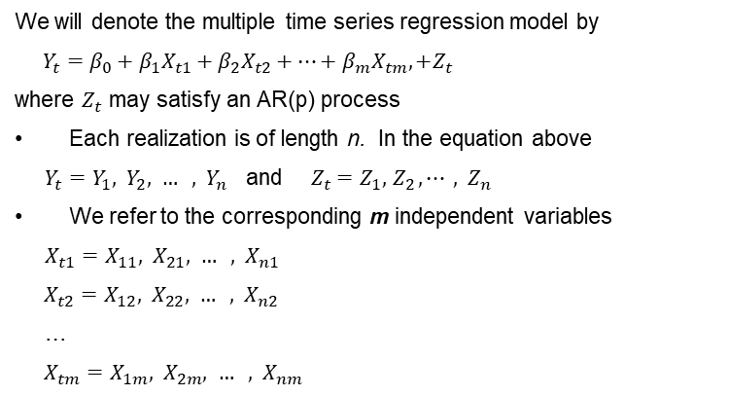
A brief reflection of thoughts and key takeaways – Week 12
multivariate approach - use more than one time-series variable to better understand data, make decisions (forecasts, etc.)
Multiple Regression with Correlated Errors
We will denote the multiple time series regression model by
${Y_{t}=β_{0}+β_{1}X}_{t1}+{β_{2}X}_{t2}+⋯+{β_{m}X}_{tm},+Z_{t}$
where $Z_{t}$ may satisfy an AR(p) process
Each realization is of length n. In the equation above
$Y_{t}=Y_{1}, { Y}_{2}, … , { Y}_{n}$ and ${{ Z}_{t} =Z}_{1}, { Z}_{2}, ⋯ , { Z}_{n}$
We refer to the corresponding m independent variables
${X_{t1}=X}_{11}, { X}_{21}, … , { X}_{n1}$
${X_{t2}=X}_{12}, { X}_{22}, … , { X}_{n2}$
…
${X_{tm}=X}_{1m}, { X}_{2m}, … , { X}_{nm}$
The first subscript is time (1, 2, … , n)
The second subscript indicates which variable it is

